Slide 1
Web Technologies
Kamran
Lecture 1

Slide 2
Text Book and Websites
Book
1) Web Engineering The Discipline of Systematic Development of Web Applications
Kappel, G., Proll, B. Reich, S. & Retschitzegger, W. (2006). Web Engineering, 1st ed. Hoboken, NJ: Wiley & Sons. ISBN: 04700-1554-3.
2) Wrox, Beginning HTML, XHTML, CSS and JavaScript, Jon Duckett
3) W3Schools.com

Slide 3
Languages and Tools
HTML
CSS
JavaScript
jQuery
AJAX
Bootstrap
PHP
ASP.NET
C#
Node Js
XAMPP , VS Code

Slide 4
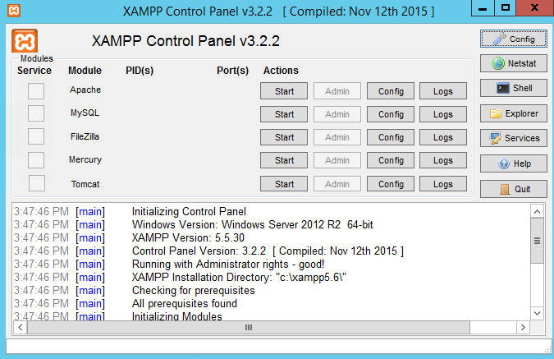
Tools

Slide 5
Motivation
The World Wide Web is omnipresent!
Why?
global and permanent availability
comfortable and uniform access
anyone can produce and publish contents

Slide 6
Web Engineering
Web Engineering:
Web engineering is basically all about designing and promoting web based systems.
Notes:
Ebay
Amazon
Paypal
Scrkil

Slide 7
What is Web Engineering
The application of systematic and quantifiable approaches to cost-effective analysis, design, implementation, testing, operation, and maintenance of high-quality Web applications.” – Kappel et al.

Slide 8
Defining Web Applications
A Web application is a system that utilizes W3C standards & technologies to deliver Web-specific resources to clients (typically) through a browser.
A strict definition that ensures software and UI aspects of the Web are examined carefully
Technology + interaction.
Web site with no software components?
Web services?

Slide 9
Development of Web Applications: today’s approach
ad-hoc development
based on knowledge, experiences and practices of individual developers
reuse of existing applications by “copy&paste” approach
insufficient documentation of design decisions
isolated activity: no “design for change”
missing methodical approach

Slide 10
Reasons for Quality Deficiencies
document-centered view
development of web applications seen as editorial activity: “ (textual) web pages, links and use of graphics”
misconception that web applications are simple
due to availability of tools like HTML-editors and form generators
no use of know-how of relevant disciplines
no use of software engineering know-how
no use of hypermedia or HCI (Human Computer Interaction) know-how

Slide 11
Web Crisis
• comparable to software crisis at the end of the 60’ies
• lead to origin of “software engineering” discipline
• “web engineering” is needed!

Slide 12
Web terminologies
Web client- machine that initiates internet request
Web server – machine that services internet request
Browser - software at the client side to interact with web data
Intranet – an internal network of computers confined to a single place
Extranet – when two or more intranets are connected with each other, they form an Extranet – e.g, Virtual Private Network
Internet – a global network of networks

Slide 13
Web teminologies
WWW = World Wide Web = Web
Global distributed information system in Internet
A service in Internet (like E-mail, DNS, ...)
Consists of set of documents (and other resources) located on different Internet servers
Accessed through standard protocols like HTTP, HTTPS and FTP by their URL
Web servers provide Web content
Web browsers display the Web content

Slide 14
Web application development
5. User receives file displayed by the browser
4. Server sends requested files to browser to be interpreted
Browser
1. User sends request
3. Server accepts
and processes
request from
browser
2. Browser interprets user’s
selection and makes request from appropriate server

Slide 15
The Case for Web Engineering
Application development on the Web remains largely ad hoc.
Spontaneous, one-time events
Individual experience
Little or no documentation for code/design
Short-term savings lead to long-term problems in operation, maintenance, usability, etc.
Because Web apps are so interdependent, the problem is compounded.

Slide 16
The Case for Web Engineering (cont.)
Root Causes of poor design
Development as an authoring activity
Development is “easy”
Techniques that should not be used are misapplied.
Techniques that should be used are not.
Particularly alarming given…
Most projects are now Web-based
More “mission-critical” apps moving to the Web

Slide 17
The Case for Web Engineering (cont.)
Top project pitfalls (Cutter, 2000)
84% - Failure to meet business objectives
79% - Project schedule delays
63% - Budget overrun
53% - Lack of functionality
Web Engineering’s solution:
Clearly defined goals & objectives
Systematic, phased development
Careful planning
Iterative & continuous auditing of the entire process

Slide 18
Categories of Web Applications
Ubiquitous
Semantic
Web
Collaborative
Social Web
Workflow
Based
Complexity
Transactional
Portal
Oriented
Interactive
Doc-Centric
Development History

Slide 19
Document-Centric Web sites
Precursors to Web applications
Static HTML documents
Manual updates
Pros
Simple, stable, short response times
Cons
High management costs for frequent updates & large collections
More prone to inconsistent/redundant info
Example: static home pages

Slide 20
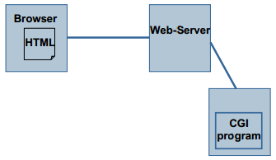
Interactive
Content of a website is dynamically generated as response to a user request
form-based input is the primary mechanism for communication between client and server
usage of HTML-forms and Common Gateway Interface (CGI) techniques
radio button, string input, choice lists
examples:
dynamic HTML pages
public transport schedules
search engines

Slide 21
Transactional
complex interactions
read and write actions
usage of transaction management of database systems
efficient and consistent data management
structured data and queries
Examples: news sites, booking systems, online banking

Slide 22
Workflow-Based Applications
A workflow application is a software tool that automates the tasks involved in a business process.
Designed to handle business processes across departments, organizations & enterprises
Business logic defines the structure
The role of Web services
Interoperability
Loosely-coupled
Standards-based
Examples: B2B & e-Government
High complexity; autonomous entities

Slide 23
Collaborative
Unstructured, cooperative environments
support cooperation in case of unstructured flow of activities and high degree of communication
examples:
support of shared information- and workspaces
Wiki, http://c2.com/cgi/wiki
chat rooms
e-Learning platforms

Slide 24
Semantic web
Berners-Lee: Information on the Web should be readable to machines, as well as humans.
information available on the web
adequate for human understanding and
adequate for automatic manipulation
„knowledge management“
derivation of new knowledge
re-use of knowledge (RSS, Atom)
based on ontology's
examples: Web 2.0, social software: wiki, Flickr, del.icio.us, Google

Slide 25
Portal-Oriented
Single points-of-entry to heterogeneous information
Yahoo!, AOL.com, portal.kfupm.edu.sa
Specialized portals
Marketplace portals (horizontal & vertical)
Daraz example of vertical marketplaces
Uber, Airbnb, TaskRabbit, METRO Market, and Rover are all examples of vertical marketplaces
Horizontal portals have “something for everyone” and appeal to a wide range of interests. Aol or Yahoo UK are prime examples, (e. B2C)
Notes:
Horizontal portals have “something for everyone” and appeal to a wide range of interests. Aol or Yahoo UK are prime examples, giving the user a convenient gateway to access popular email, news, weather and other information that might be valuable.
They offer their users gateways to the web with convenient links to breaking news, social media, sports, horoscopes, etc. They are a bit like opening the Sunday newspaper, where you get a choice of many interesting topics to sit and browse at will.

Slide 26
Ubiquitous web applications (UWA)
UWA are a new type of web applications which are accessed in various contexts, i.e. through different devices, by users with various interests, at anytime from anyplace around the globel
HCI is critical
Limitations of devices (screen size, bandwidth?)
Context of use
Still an emerging field; most devices have single focus:
Personalization
Location-aware
Multi-platform delivery
Notes:
Ubiquitous web applications (UWA) are a new type of web applications which are accessed in various contexts, i.e. through different devices, by users with various interests, at anytime from anyplace around the globe

Slide 27
Characteristics of Web Apps
How do Web applications differ from traditional applications?
Or, another way, what Software Engineering methods & techniques can be adapted to Web Engineering?
3 dimensions of the ISO/IEC 9126-1 standard
Product
Usage
Development
To this we can add a 4th dimension peculiar on the web, need for continuous and fast evolution!

Slide 28
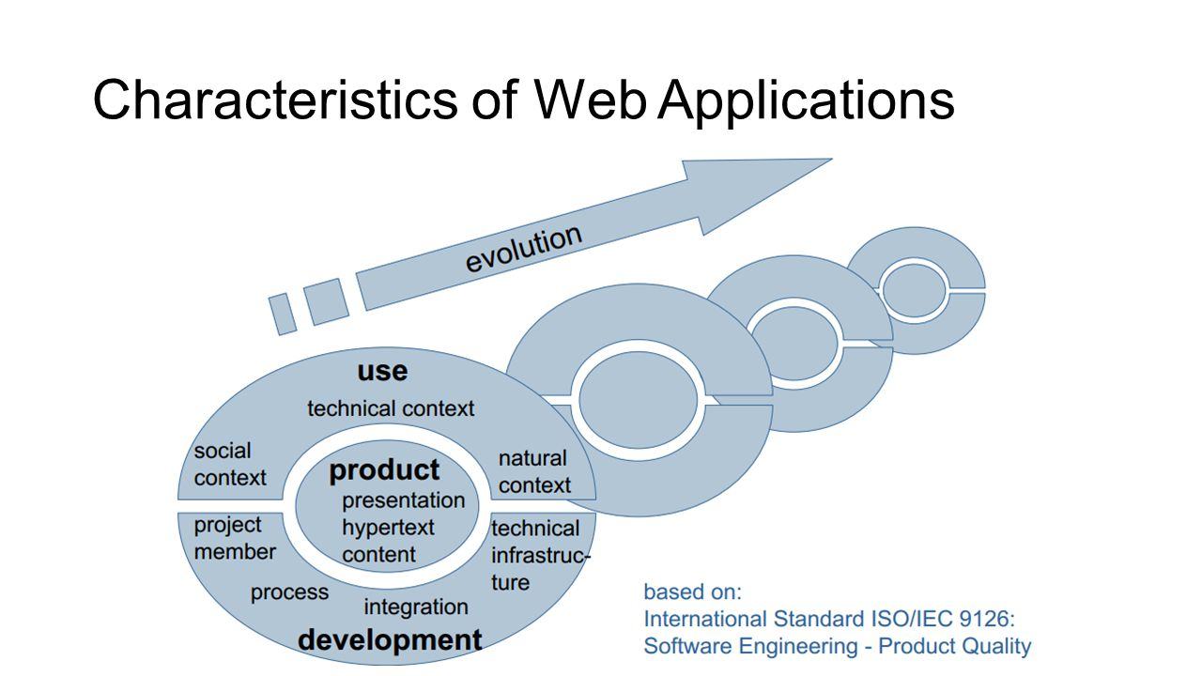
Characteristics of Web Apps
How do Web applications differ from traditional applications?
Or, another way, what Software Engineering methods & techniques can be adapted to Web Engineering?
3 dimensions of the ISO/IEC 9126-1 standard
Product
Usage
Development
To this we can add a 4th dimension peculiar on the web, need for continuous and fast evolution!

Slide 29
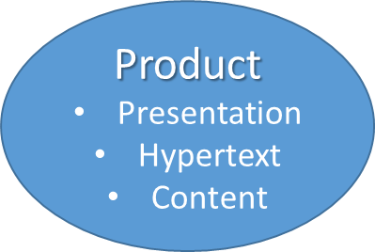
Characteristics - Product
Product-related characteristics constitute the “building blocks” of a Web application
Content
document-centered and multi-media text, tables, graphics, animation, audio, video
main objective of web applications is to communicate content high usability demands
Quality demands: current, exact, consistent, reliable
Navigation Structure (Hypertext)
Non-linearity , Potential problems: Disorientation & cognitive overload
User interface (Presentation)
Aesthetics
Self-explanation
Notes:
Content:
special requirements on usability
Content is in part also generated and updated dynamically; e.g. the
number of available rooms in a tourism information system. Furthermore, the Web serves
as an infrastructure for the transmission of multimedia content, e.g. in video conferences
or Real Audio applications.
quality metrics regarding its being up to date, exact, consistent and reliable
Navigation:
Hypertexts imply stereotypes of relatively systematic reading, and in this,
Web applications differ fundamentally from traditional software applications. We can
distinguish among others between browsing, e.g. in online shopping applications, queries,
e.g. in virtual exhibitions, and guided tours, e.g. in e-learning applications.
Disorientation is the tendency to lose one’s bearings in a non-linear document. Cognitive
overload is caused by the additional concentration required to keep in mind several paths or
tasks simultaneously.
UI:
Besides aesthetics, it is essential that Web applications are selfexplanatory,
i.e. it should be possible to use aWeb application without documentation.

Slide 30
Characteristics of Web Applications: Content
Product-related characteristics constitute the “building blocks” of a Web application
document-centered and multi-media
text, tables, graphics, animation, audio, video
main objective of web applications is to communicate content
high usability demands
high quality demands
actuality, preciseness, correctness, reliability, size
e-shopping: information about price, availability of products
quality is critical factor for acceptance of web applications
Product
Presentation
Hypertext
Content

Slide 31
Characteristics of Web Applications: Hypertext
non-linearity
main distinction to traditional software systems
systematic reading (“browsing, query, guided tour”)
navigation in information space depends on interest and previous knowledge of user
great challenge for web application authors
risks
disorientation: loss of sense of locality and direction
cognitive overload for users
Product
Presentation
Hypertext
Content

Slide 32
Characteristics of Web Applications: Presentation
aesthetics
look and feel
depending on current fashion
self-explanatory
intuitive use without reading any documentation
uniform application logics
Product
Presentation
Hypertext
Content

Slide 33
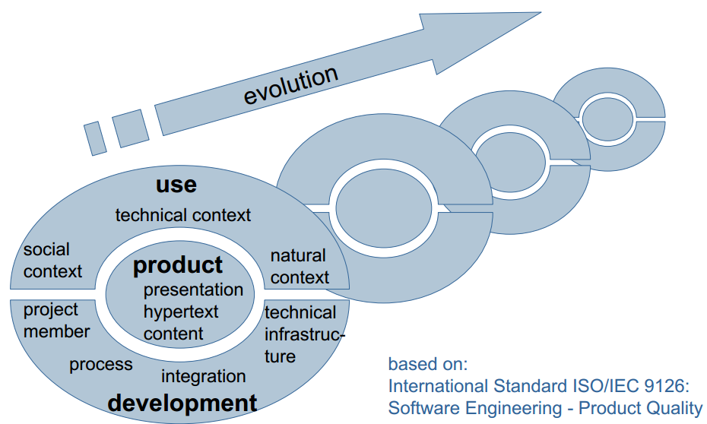
Characteristics of Web Applications

Slide 34
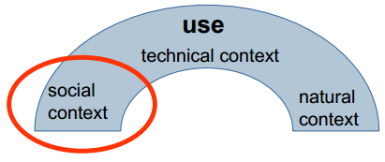
Characteristics of Web Applications:
spontaneity
users come and go ..
unknown number of users
scalability important issue
multiculturality
anonymous type of user
limited knowledge about previous knowledge, handicaps, preferences of users
desired adaptation of content and presentation

Slide 35
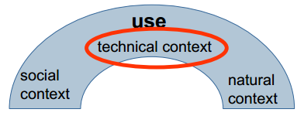
Characteristics of Web Applications:
quality of service
unknown network characteristics (e.g., bandwidth, reliability)
multi platform delivery
different types of devices (PC, tablet, mobile phone)
different versions of browsers
different degree of functionality, performance, display size, …

Slide 36
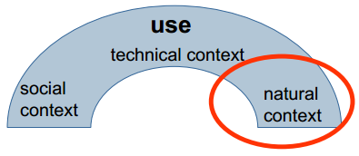
Characteristics of Web Applications:
place and time of access
globality
internationalization of web applications
regional, cultural, linguistic differences have to be taken into account
demands on security
prevent access to private or confidential data
availability
instant delivery mechanism (also in case of partial realizations)
permanent (24/7)
time-dependent services

Slide 37
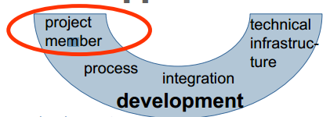
Characteristics of Web Applications:
multi disciplinary
mixture of
print publishing and software development
marketing and computer science
art and technology
IT-experts, hypertext experts, UI designer, domain experts, …
young average age of developers
“technology freak”
community development
open source
open content

Slide 38
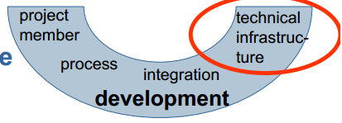
Characteristics of Web Applications:
inhomogeneity
two essential components
Web server (under control of developer)
Web browser (out of control of developer)
immaturity
“buggy” components due to time-to-market pressure
continuous evolution of base technology

Slide 39
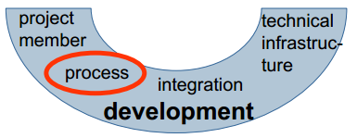
Characteristics of Web Applications:
flexibility
changing requirements
changing context
requires agile, light-weight processes
parallelism
of development of parts of web applications
of development steps

Slide 40
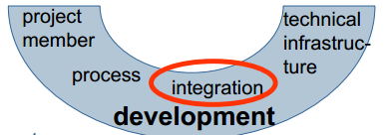
Characteristics of Web Applications:
internal integration
add web access to legacy systems
external integration
of content and services of external web applications (“web services”)
similarity to integration of heterogeneous database systems, but
high autonomy of sources w.r.t. to availability and change
few detailed information about sources
heterogeneity on different levels (data, schema, data model)

Slide 41
Characteristics of Web Applications

Slide 42
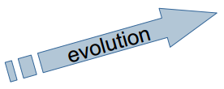
Characteristics of Web Applications:
All the above mentioned dimension are governed by the evolution principle
continuous change
permanent evolution
changing requirements and contexts
change of characteristics product, use, or development
competitive pressure
time-to-market
necessity of web presence
leads to shorter product life cycles
leads to shorter development cycles
fast pace
“either you are fast or irrelevant”

Slide 43
Reading Assignment
Read first chapter of book (Web Engineering
The Discipline of Systematic Development
of Web Applications by Gerti Kappel )

Slide 44
Web Technologies Basics
?
?
?
?
?
Questions?
?
?
?
?
?
http://academy.telerik.com

